Slide 1

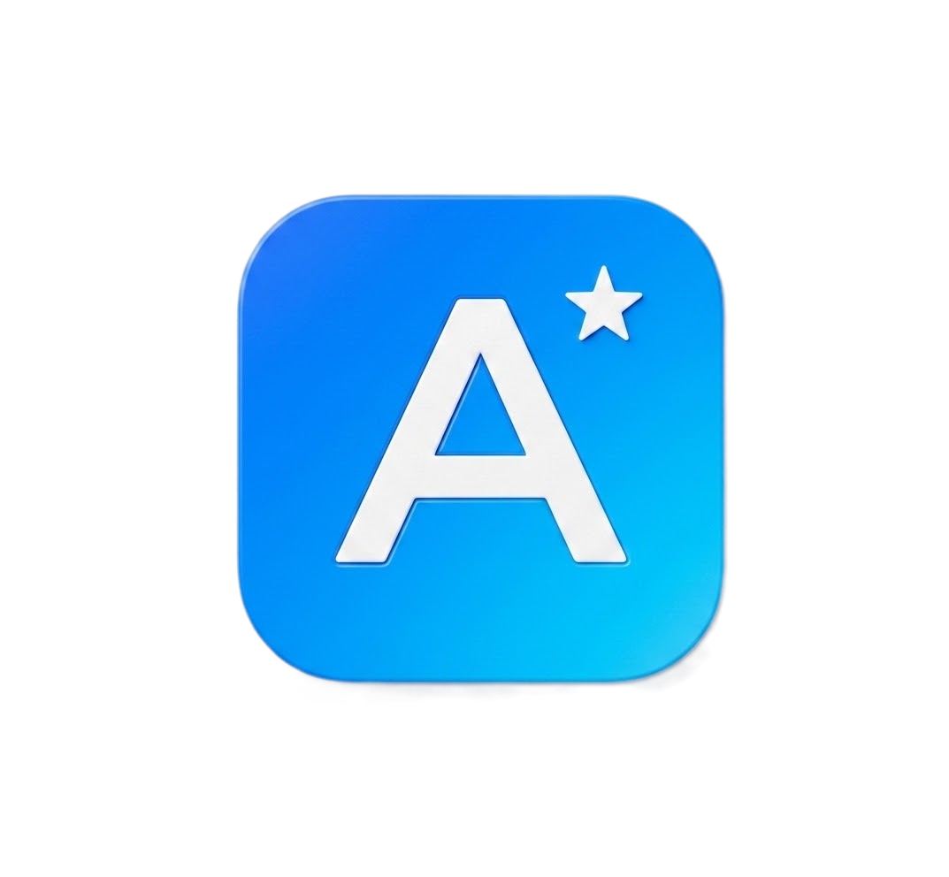
AIRAM
AI-Assisted Requirement Analysis & Management

Slide 2

Use Case
Manual validation of automotive requirements against standards like ASPICE and ISO 26262 introduces severe bottlenecks:
1.
2.
3.
Time-Consuming
Evaluating complex standard requirements manually demands massive engineering hours, severely delaying product time-to-market.
Prone to Error
Human review struggles to guarantee total accuracy against dense specifications, increasing safety-critical compliance risks.
Highly Inconsistent
Validation outcomes and syntax reviews lack uniformity, varying widely between isolated engineering teams.
TCS Confidential

Slide 3








The AIRAM Solution
Quality Audit
Auto-Correction
Traceability
Automates the evaluation of requirements against stringent INCOSE guidelines and EARS syntax using advanced LLMs, ensuring immediate compliance detection.
Automatically corrects invalid requirements and splits complex ones into single, easy-to-test statements
Performs semantic matching to ensure bidirectional coverage between High-Level (SWE.1) and Low-Level (SWE.2) requirements, instantly flagging orphans.
TCS Confidential

Slide 4
















Agentic Workflows & Traceability
EXPANDING THE V-CYCLE AUTOMATION
Test Case Generation
Change-Impact Analysis
Diagram Generation
Diagram Consistency
Auto-draft verification tests (SWE.4–6) linked directly back to the source requirement ID.
Automatically draft sequence, class, and state diagrams (Mermaid) from requirements sets.
Parses diagram elements visually and flags missing gaps or orphans against requirements.
Instantly flags when downstream SWE.2s and test cases go stale due to an SWE.1 edit.
TCS Confidential

Slide 5














Collaboration & User Experience
ENHANCING TEAM VISIBILITY AND ACCESS
Role-Based Dashboards
Chatbot
Teams / Slack Alerts
Baseline Versioning
Send instant notifications
Or raise tickets
Freeze an approved requirement set as an immutable milestone snapshot for ASPICE audits.
Separate, tailored views and controls for Authors, Reviewers, and Team Leads.
Chat interface to properly communicate "Which SWE.2s cover the trigger?" instead of filtering complex tables.
TCS Confidential

Slide 6








Enterprise Governance
AUDITABILITY AND INFRASTRUCTURE SCALING
Multi-Agent Orchestrator
Full LLM Audit Trail
Persist model version, prompt hash, and confidence scores for every call, not just the final verdict.
A thin dispatcher routing each process to specialized agents instead of one linear script.
TCS Confidential

Slide 7
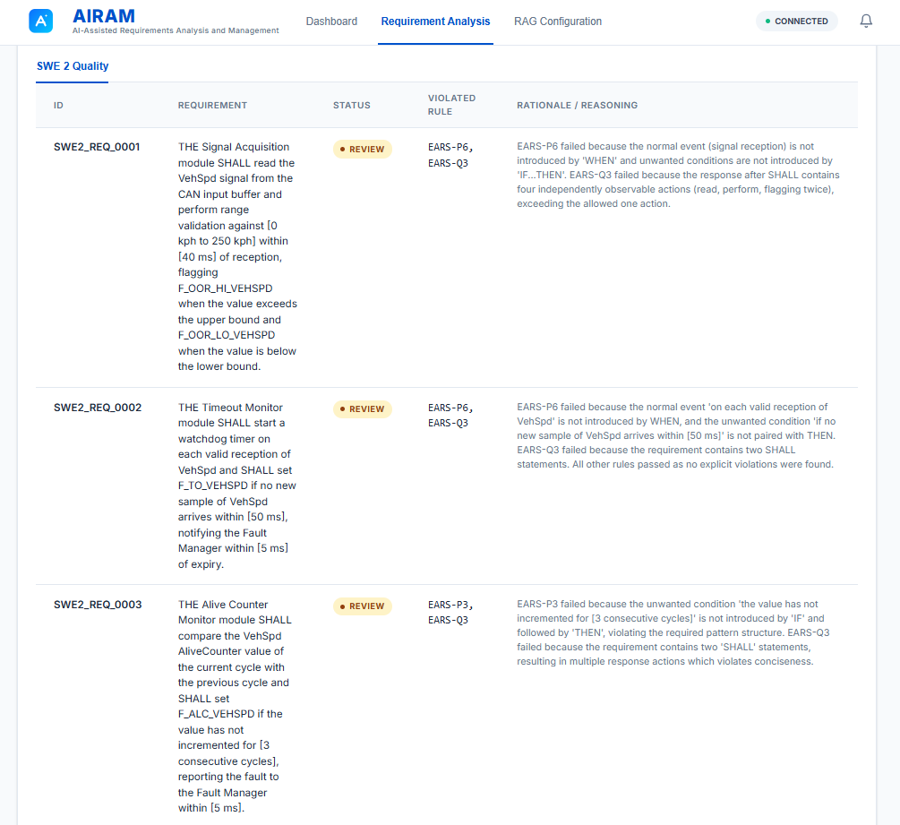
Current Capability: Quality Auditor
The core evaluation engine audits individual software requirements against strict engineering guidelines with unprecedented accuracy.
It supports intelligent RAG retrieval, strict JSON rule enforcement, and custom evaluation contexts to deliver precise PASS/REVIEW verdicts with detailed, structured rationale.
A secondary LLM recheck mechanism ensures subtle violations missed in the first pass are captured, guaranteeing assessment rigor.
TCS Confidential

Slide 8
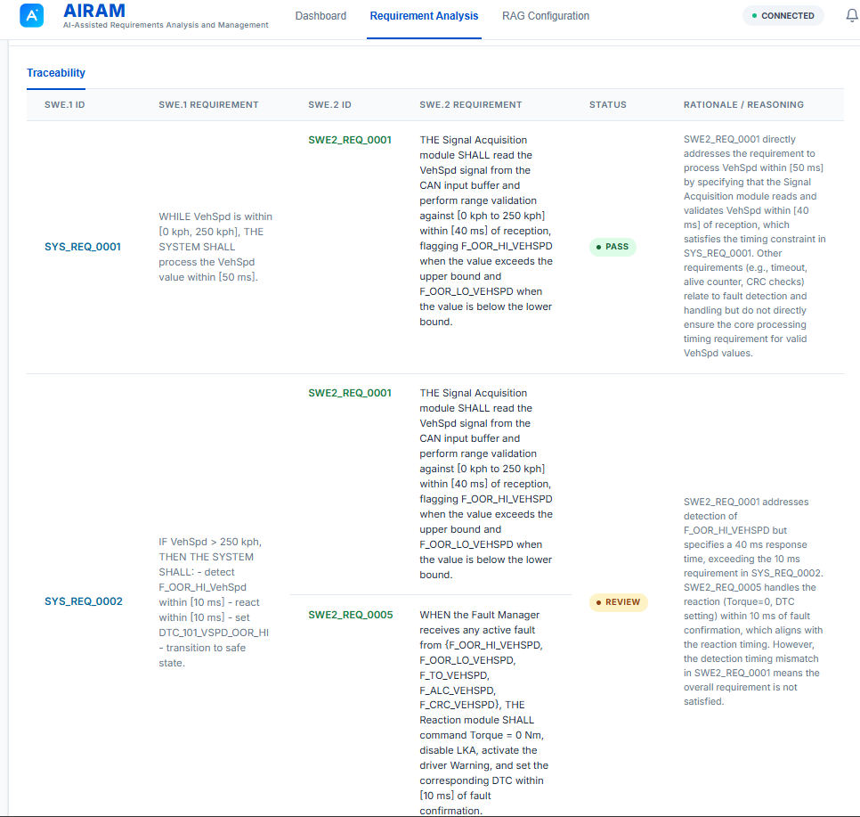
Current Capability: Traceability
Analyzer
•
Evaluates bidirectional tracing compliance between High-Level (SWE.1) and Low-Level (SWE.2) requirements effortlessly.
•
Utilizes Large Language Model semantic matching to accurately identify valid requirement links, going beyond simple keyword searches.
•
Automatically flags orphaned SWE.2 requirements lacking parent HLR coverage to prevent scope creep.
•
Processes large datasets efficiently with intelligent context window management and batch execution.
TCS Confidential

Slide 9



Advanced Knowledge (RAG) Engine
Intelligent Ingestion
Semantic Retrieval
Progressively parses and intelligently chunks complex documentation including PDFs, Excel sheets, CSVs, JSON, and TXT files. It leverages cutting-edge extraction models to embed data into a highly scalable Qdrant vector database.
Provides highly relevant engineering guidelines as direct context for LLM audits. This ensures that automated compliance checks are deeply rooted in your organization's specific standards, rather than generic AI knowledge.
TCS Confidential

Slide 10
Technology Stack
Frontend Framework: Angular 22 framework with TypeScript, utilizing a clean, component-based architecture and real-time SSE streaming for long-running processes.
Backend Architecture: High-performance FastAPI application written in Python 3.10+, backed by an embedded SQLite database (with Postgres readiness for cloud).
AI & Foundation Models: Powered by the NVIDIA NIM API, utilizing the state-of-the-art Llama 3.3 Nemotron 49B model and nv-e5-v5 for highly accurate embeddings.
Vector Storage: Integrates seamlessly with Qdrant Cloud for robust semantic search, context retrieval, and fast document metadata filtering.
TCS Confidential

Slide 11
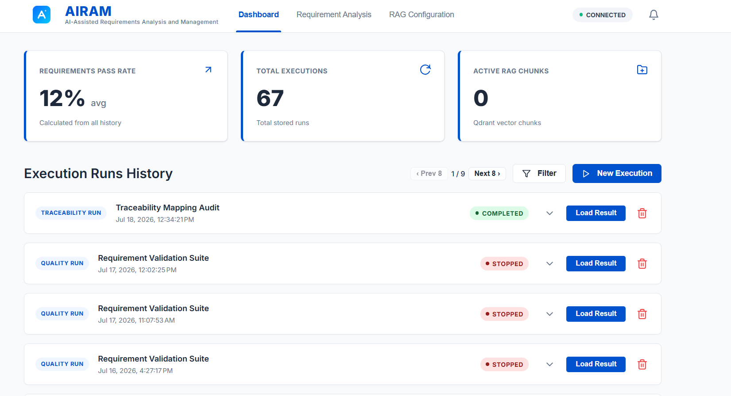
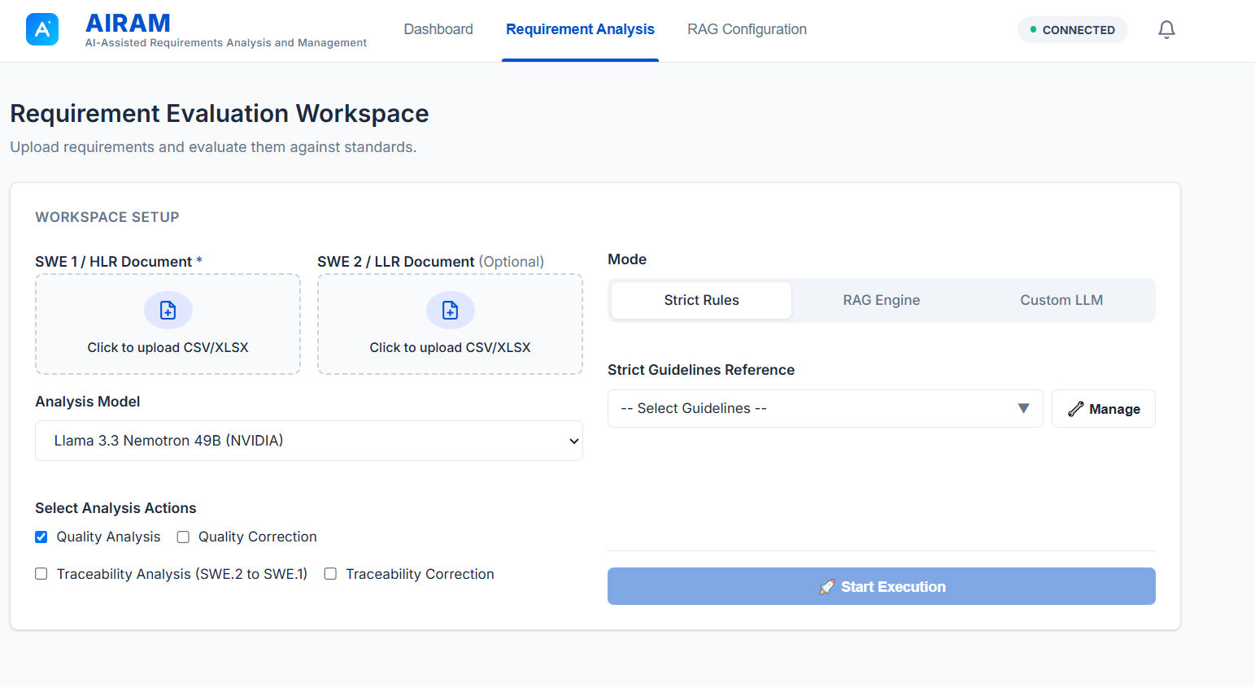


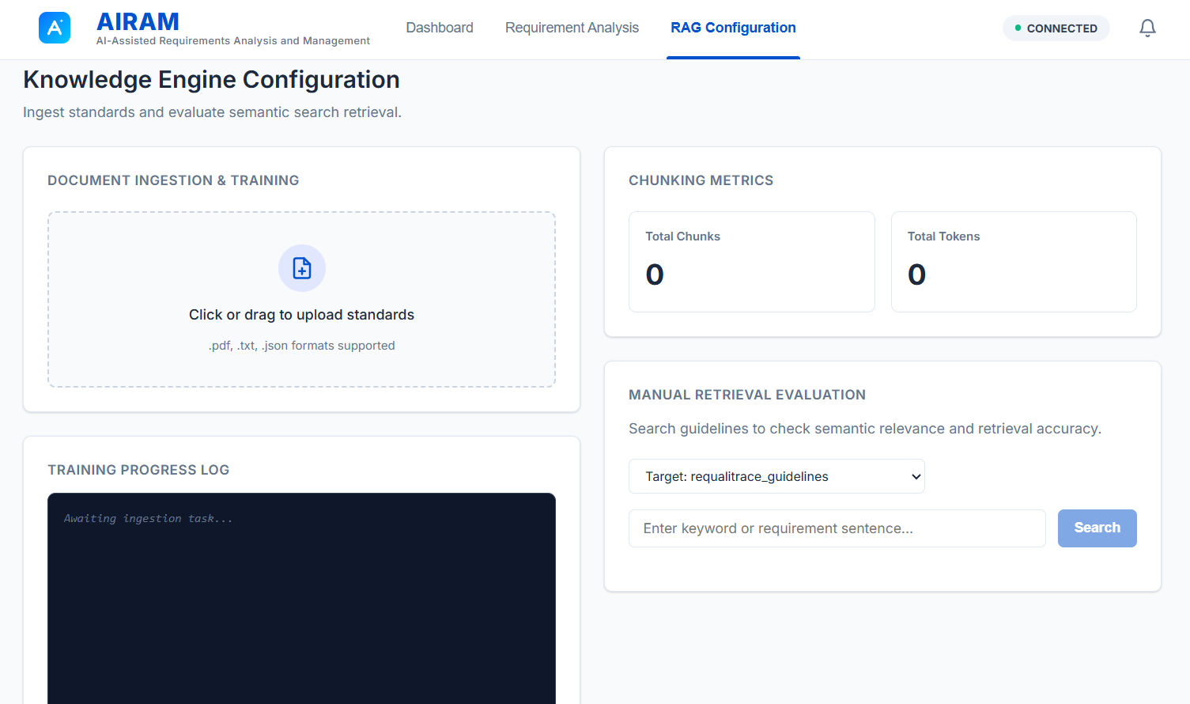
Platform Interface Overview
Dashboard Analytics
Evaluation Workspace
Knowledge Config
Track compliance trends and execution history.
Upload files and control real-time analysis execution.
Manage standards and evaluate semantic retrieval.
TCS Confidential

Slide 12
Thank you

